Slide 1

SOS CARE INDIA

Slide 2
Our values
Trust :- Our 10 year track record earned us the trust of charities & donors.
Dynamism :- We are enthusiastic about our ability to fuel positive change.
Human Touch :- We deliver professional services with a personal touch.
Confidence :- We are optimistic about the future and not afraid to take risk.

Slide 3
Introduction
SOS Care India established with an aim to provide equal opportunities for economic empowerment, women empowerment, self employment, skill development and promotion of rural artisans, provide support to women entrepreneur & micro small medium enterprises (MSME). SOS care is also committed to provide every possible support for any kind of natural disaster.

Slide 4
Vision & Mission
Economic Empowerment
Women Empowerment
Promotion Of Rural Artisans
Financial Development
Self Employment

Slide 5
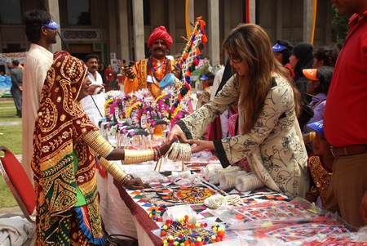
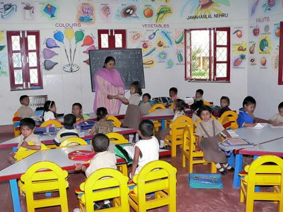
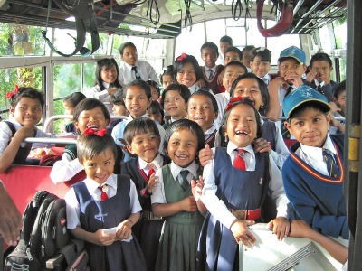
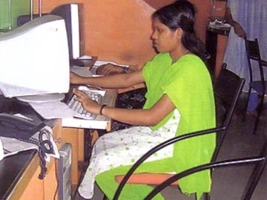
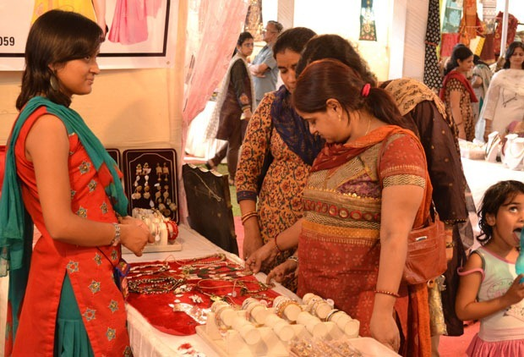
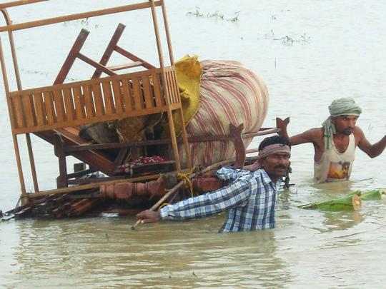

Slide 6
Our Services
Events
Seminars
Exhibition
Rural Contact Program
NGO Communication
Retail Expansion
Awareness Program

Slide 7

Our reach
6 National Offices across
  Delhi
  Mumbai
  Bangalore
  Chennai,
  Hyderabad
  Kolkata
  22 States, 589 Towns

Slide 8
SOS economic empowerment programme –07
Rakhi campaign at the time of Raksha Bandhan
Deepawali Campaign :- “VIKASH JYOTI PRAKASH JYOTI”
SOS CARE Newsletter
SOS Membership Campaign (25 Dec to 05 Jan.)
SOS CARE Annual Seminar on Women Entrepreneurs
SOS CARE Outreach initiative
SOS CARE Sponsor Programme
SOS CARE Counseling Center
SOS CARE Banking Network
NGO Network Programme
SOS CARE Village Conferences
SOS CARE Health Program
SOS CARE Publicity & Resource Mobilization
SOS CARE Disaster Team
SOS CARE Rehabilitation Programme
SOS CARE CSR Programme
O
u
R
P
R
O
G
R
A
M
s

Slide 9
Our achievements
Seminar, IITF, 15-16th Nov.'05 in Pragati Bhawan at ITPO
Handicraft Exhibition on 13, 14 & 15 Jan. 2006 at ITPO
SOS CARE delegation meets the President of India Dr. A.P.J Abdul Kalam on Aug-9 , on the day of Rakhi Festival
National Exhibition cum Buyer Sellers meet , Spice World NOIDA
National Workshop cum Training of Women Entrepreneurs and Buyer Sellers meet , Dilli Hat , New Delhi
International Exhibition cum Buyer & Sellers meet, Ashoka Hotel and Vigyan Bhavan, New Delhi
National Exhibition Sajawat , September 16-24, Pragati Maidan, New Delhi
International IITF- Exhibition cum Buyer Sellers meet , November 14-27, Pragati Maidan , New Delhi
National Launch of all India Women Entrepreneurs Directory -2007, New Delhi

Slide 10
WORK DONE TILL DATE
Handicraft Exhibition
Jan. 2006
at ITPO
SOS CARE delegation meets
The President of India
Aug-09
National Exhibition cum BSM, SpiceWorld
NOIDA
Seminar, IITF,
Nov.'05 in
Pragati Bhawan
International Exhibition cum BSM, Ashoka Hotel and Vigyan Bhavan, New Delhi
National Launch of all India Women Entrepreneurs Directory -2007, New Delhi
National Workshop cum Training of Women Entrepreneurs and Buyer Sellers meet , Dilli Hat , New Delhi
National Exhibition Sajawat , September 16-24, Pragati Maidan,
New Delhi
  International IITF Exhibition cum BSM, November 14-27, Pragati Maidan , New Delhi

Slide 11
VENUE | LOCATION | DATE
Centrestage Mall | Noida | 16th Jan,07 to 05th Feb,07
Pacific Mall | Ghaziabad | 14th Feb,07 to 07th Mar,07
Pacific Mall | Pitampura | 27th Mar,07 to 22th Apr,07
V3S mall | Laxminagar | 14th May,07 to 04th Jun,07
Ansal Plaza | Ghaziabad | 04th Jun,07 to 08th July,07
Pacific Mall | Ghaziabad | 21st Jul,07 to 12th Aug,07
Agrawal City Mall | Pitampura | 24th Sep,07 to 07th Oct,07
Ansal Plaza(Hudco Place) | Khelgaon | 17th Oct,07 to 22th Oct,07
Pacific Mall | Ghaziabad | 27th Oct,07 to 09th Nov,07
IITF,07 Pragati Maidan | New Delhi | 14th Nov,07 to 27th Nov,07
Spice World Mall | Noida | 09th Dec,07 to 09th Jan,08

Slide 12
MMX Mall | Ghaziabad | 28th Dec,07 to 26th Jan,08
Shipra Mall | Ghaziabad | 24th Jan,08 to 17th Feb,08
Pacific Mall | Ghaziabad | 01st Mar,08 to 16th Mar,08
Cross River Mall | Karkardoma | 04th Apr,08 to 04th May,08
OMAXE Park Plaza Mall | Indirapuram | 17th May,08 to 10th Jun,08
Pacific Mall | Ghaziabad | 30th May,08 to 22th Jun,08
TDI Mall | Rajauri Garden | 04th Jul,08 to 27th July,08
Shopprig Mall | Noida | 08th Aug,08 to 01st Sep,08
Gurgaon Trade Fair | Gurgaon | 20th Aug,08 to 26th Aug,08
Noida Trade Fair | Noida Sec-32A | 05th Sep,08 to 14th Sep,08
Ansal Plaza | Dabur Chowk, Gzd | 20th Sep,08 to 17th Oct,08
Shopprix Mall | Noida,Sec 61 | 11th Oct,08 to 02nd Nov,08
Pacific Mall | Ghaziabad | 22nd Oct,08 to 09th Nov,08
IITF,08 Pragati Maidan | New Delhi | 14th Nov,08 to 27th Nov,08
Sahara Mall | Gurgaon | 28th Nov,08 to 21st Dec,08

Slide 13
Exhibition Cum Buyer Seller Meet, OMAXE Park Plaza Mall,Indirapuram, 17th May,08 to 10th Jun,08
Exhibition Cum Buyer Seller Meet Cross River Mall,Karkardooma,04th Apr,08 to 04th May,08
Exhibition Cum Buyer Seller Meet, Pacific Mall,Gbd, 30th May,08 to 22th Jun,08
Exhibition Cum Buyer Seller Meet, TDI Mall, Rajauri Garden, 04th Jul,08 to 27th July,08
Exhibition Cum Buyer Seller Meet, Shopprix Mall, Noida, 08th Aug,08 to 01st Sep,08
Exhibition Cum Buyer Seller Meet, Gurgaon Trade Fair, Gurgaon, 20th Aug,08 to 26th Aug,08
Exhibition Cum Buyer Seller Meet, Noida Trade Fair, Noida Sec-32A, 05th Sep,08 to 14th Sep,08
Exhibition Cum Buyer Seller Meet, Ansal Plaza, Dabur Chowk,Gzd, 20th Sep,08 to 17th Oct,08
Exhibition Cum Buyer Seller Meet, Shopprix Mall, Noida,Sec 61, 11th Oct,08 to 02nd Nov,08
Exhibition Cum Buyer Seller Meet, Pacific Mall,Gbd, 22nd Oct,08 to 09th Nov,08
Exhibition Cum Buyer Seller Meet, IITF,08 Pragati Maidan, Delhi, 14th Nov,08 to 27th Nov,08
Exhibition Cum Buyer Seller Meet, Sahara Mall, Gurgaon, 28th Nov,08 to 21st Dec,08
Exhibition Cum Buyer Seller Meet, DLF CITY CLUB,Gurgaon,25thDec,08 to 28thDec ,08
Exhibition Cum Buyer Seller Meet, Pacific Mall,Gbd, 08thJan 09 to 08thFeb, 09
Exhibition Cum Buyer Seller Meet, SHOPPRIX MALL,Noida,Sec-61,27thJan to 09th Feb 09
Exhibition Cum Buyer Seller Meet, The Great India Place,Noida,Sec-37,14th Feb to 01st Mar 09
Exhibition Cum Buyer Seller Meet, SHOPPRIX MALL,Vaishali,Sec-4,Gzb,05th Mar to 29th Mar 09.

Slide 14
Pacific Mall | Ghaziabad | 10th Apr.09 to 10th May,09
Gaur Gravity | Indirapuram | 01st May,09 to 31st May,09
Vasant Square Mall | Vasant Kunj,N.D. | 09th May,09 to 17th May,09
Shopprix Mall | Vaishali | 29th May,09 to 22nd Jun,09
DLF City Centre Mall | Shalimar Bagh,N.D | 05th July,09 to 27th July,09
Crown Plaza Mall | Faridabad | 29th July,09 to 23rd Aug,09
Spice World Mall | Noida | 07th Aug,09 to 23rd Aug,09
Shipra Mall | Ghaziabad | 22nd Aug,09 to 14th Sept,09
Shopprix Mall (Diwali) | Vaishali | 19th Sept,09 to 18th Oct,09
Spice World Mall(Diwali) | Noida | 26th Sept,09 to 17th Oct,09
Ansal Plaza,HUDCO PL. | Khelgaon,N.D. | 08th Oct,09 to 16th Oct,09(10th)
Centrestage Mall | Noida | 09th Oct,09 to 01st Nov,09

Slide 15
Pacific Mall | Ghaziabad | 24th Oct,09 to 10th Dec,09
Shilpotsav Noida-2009 | Noida | 30th Oct,09 to 08th Nov,09
IITF,09 Pragati Maidan | New Delhi | 14th Nov,09 to 27th Nov,09
Spice World Mall | Noida | 04th Dec,09 to 3rd Jan,10
DLF City Centre Mall | Shalimar Bagh,N.D | 11th Dec,09 to 13th Dec,09 (3day
Crown Interioz Mall | Faridabad | 24th Dec,09 to 10th Jan,10
DLF City Centre Mall | Shalimar Bagh,N.D | 18th Dec,09 to 03rd Jan,10
Crown Plaza Mall | Faridabad | 12th Jan,10 to 31st Jan,10
Metro Walk | Rohini,N.D. | 22nd Jan,10 to 01st Feb,10
Shopprix Mall | Noida Sec-61 | 30th Jan,10 to 21st Feb,10
Metro Walk | Rohini,N.D. | 19th Feb,10 to 01st Mar,10
Spice World Mall | Noida | 05th Mar,10 to 04th Apr,10
Living Style Mall | Jasola,N.D. | 08th Mar,10 to 28th Mar,10
DLF City Centre Mall | Shalimar Bagh,N.D | 13th Mar,10 to 25th Apr,10

Slide 16
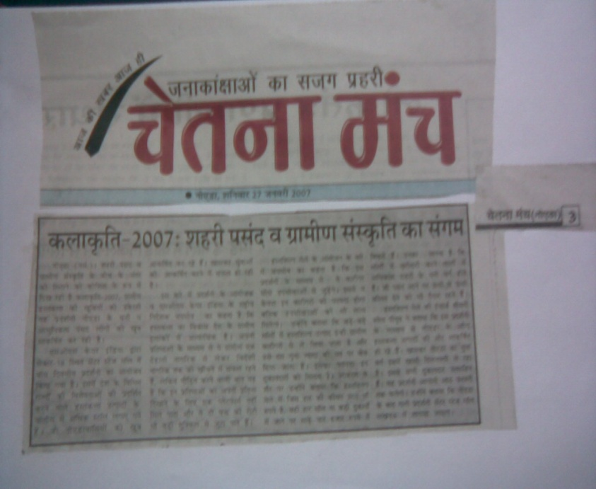
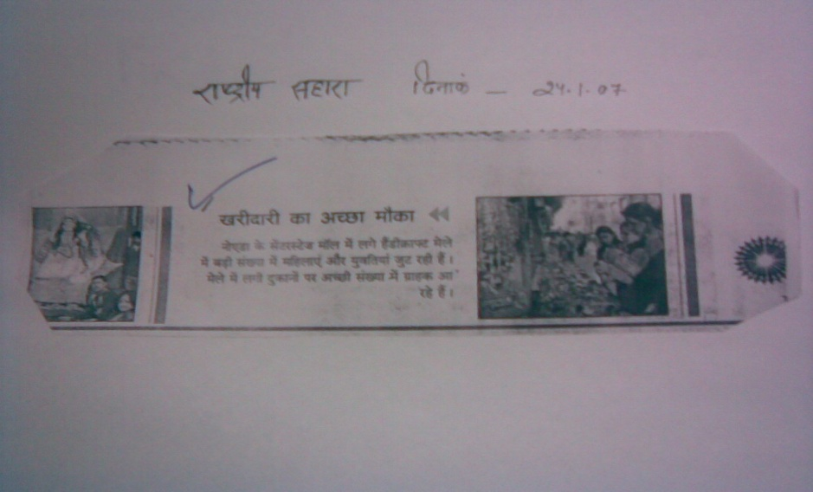
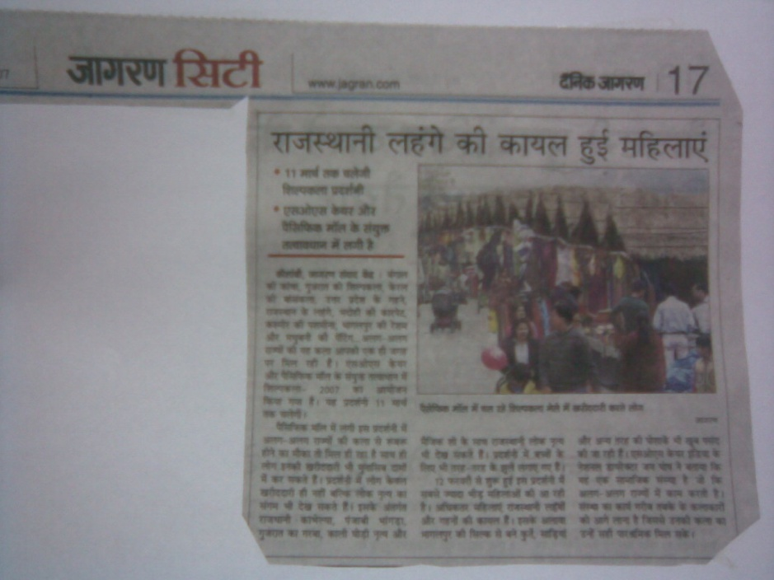
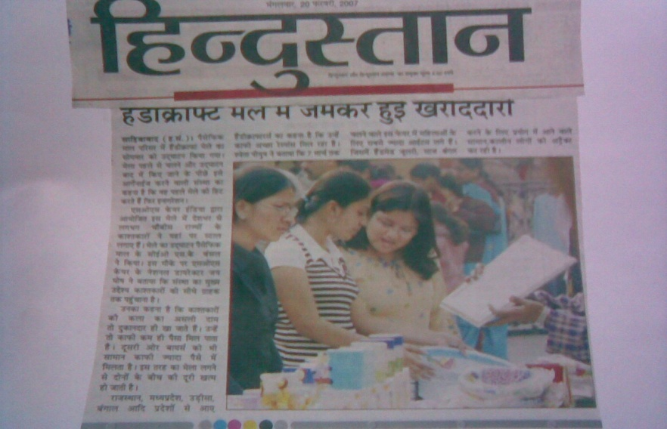
SOS IN LIMELIGHT

Slide 17
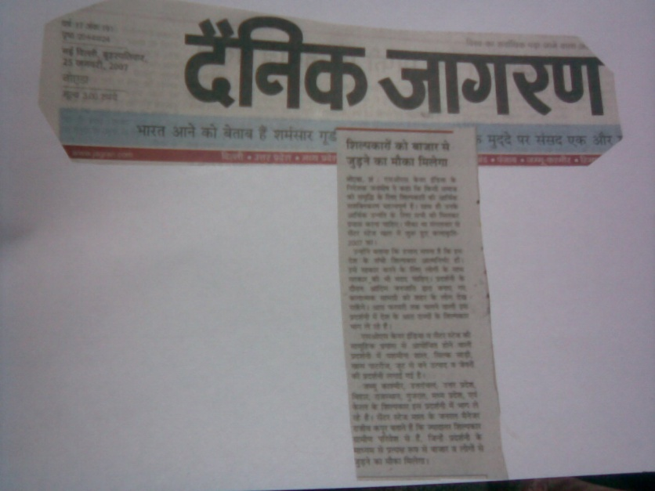
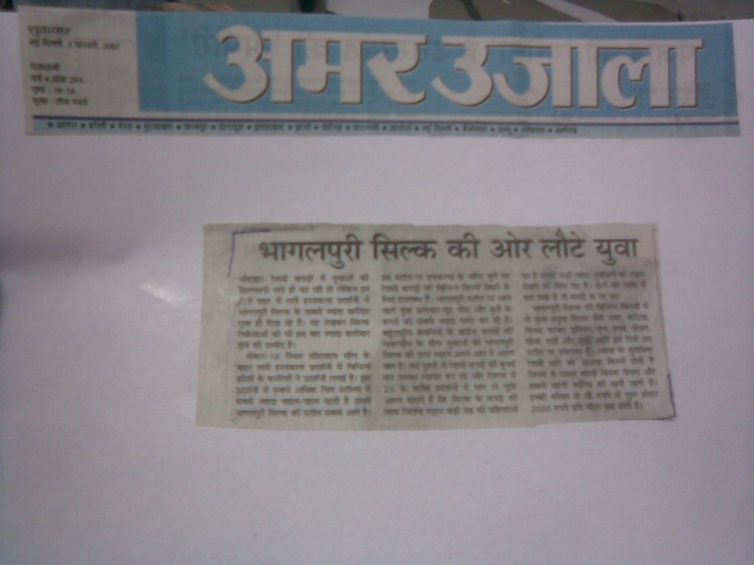
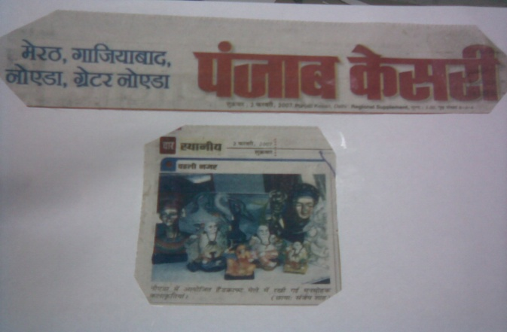
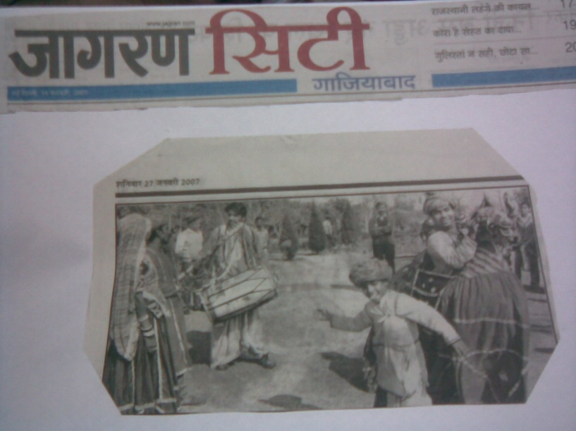
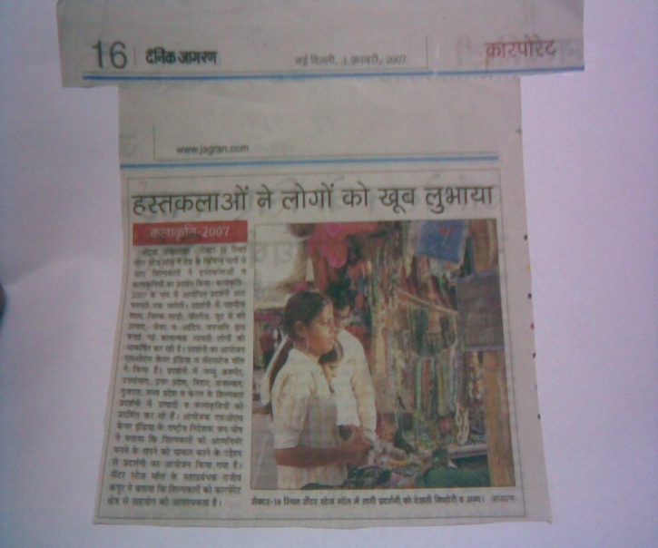

Slide 18







MEMBERS OF SOS

Slide 19































OUR PARTNERS

Slide 20























MALL PARTNERS

Slide 21








MEDIA PARTNERS

Slide 22
THANK YOU

